Slide 1
Basic Working with Linux
Let’s learn basic linux command.
We are going to learn these commands(ls,cat,cd,pwd,whoami)

Slide 2
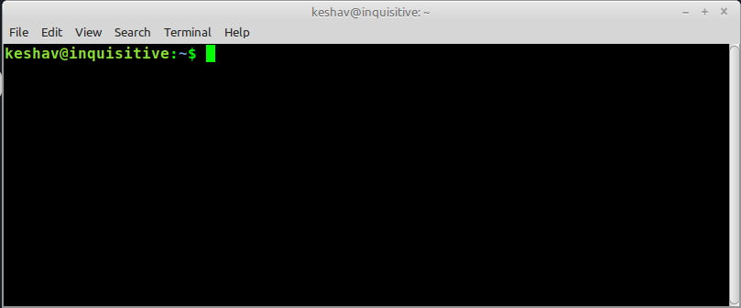
Let’s start which ‘ls’ command.
ls:command used to list the content of files/folders,
Lets see practical of ls command, open your terminal

Slide 3
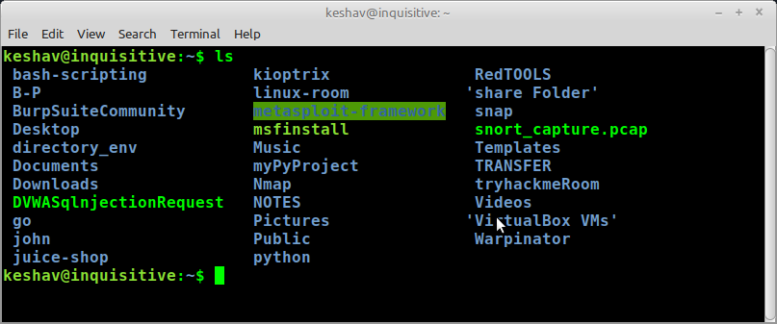
Type ls commagicmand and see
In above figure you can see after typing ls command,
list of all files/folder printed

Slide 4
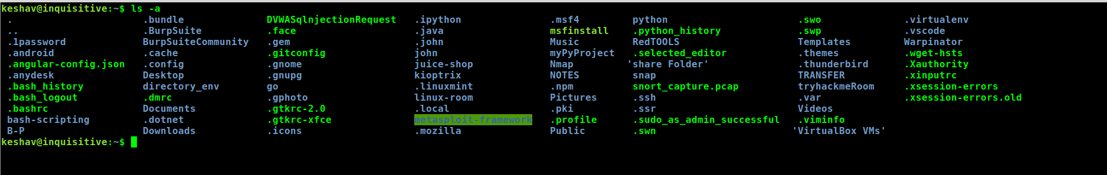
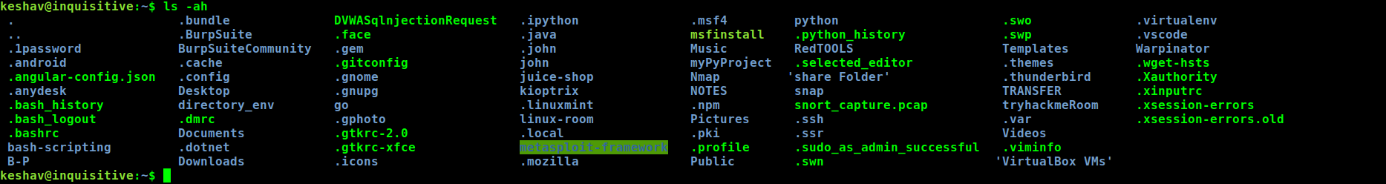
Let’s see (another magic of 'ls' command),
In our linux machine Hidden files/folder also present,
let's print those files/folder
Compare it with previous result, lets used one more feature of ‘ls’ command,
now add ‘h’ with -a→ -ah

Slide 5
Example 2
Use man page to learn all feature of any command.
Syntax: man <command> → example man ls
After typing ‘man ls’ you can see all details about any command,
Some man page not available in that case you can use this syntax: <command> -help/–help/-h.
Some time ‘ls -h’ this syntax work,
Some time ‘ls -help’ this syntax work,
Some time ‘ls –help’ this syntax work,
Example 3
Example 1

Slide 6

cd: ‘cd’ is another most useful linux command.
cd stand for change directory ,
We use this command to move one directory to another directory/folder,
Let’s see practical of cd command.
Used this syntax for return back to previous directory → cd ..

Slide 7
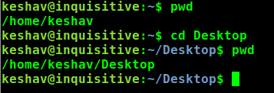
How to conform we moving one directory to another or not.
For this we can use ‘pwd’ command,
‘pwd’:pwd stand for present working directory,
Let’s see example how we can use it.
Before using cd command we are in this folder/directory
After using cd command we moved in this folder/directory

Slide 8

whoami: whoami command used to find the user name of machine,
For example in social media we have a use-name,
same i linux we also have a use-name ,
For finding our linux machine user name use this ‘whoami’ command.
This is my machine user name in your it is different

Slide 9
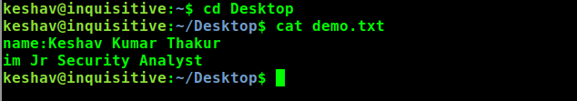
cat: cat command used to display content of file,
In which scenario we use this ‘cat’ command,
Suppose we have text file (it is not necessary that it should be txt file, it may be any file),
Let’s see practical example

Slide 10
Working With Linux Text Editor

Slide 11
There are many text editor tool in Linux
There are two text editor which is mostly used
1)vim
2)nano
many more are available but these are well known.
This presentation for beginner , vim are not good for beginner , that’s why im going to teach you nano.
Nano is usually pre-installed on most Unix-based systems, but if it is not, you can install it using your system's package manager, syntax for installing apt-get install nano
let's know how we can edit our file with this nano tool/software.
practical demo
Open your terminal (note: if nano not present, install it), now move into any folder in which you have a file, which you want to edit.

Slide 12
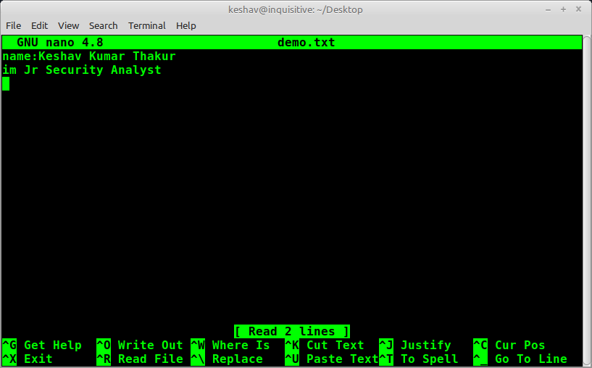
I moved to Desktop folder where i have a demo.txt , follow syntax to open any file.
After typing above command you get a prompt like this below figure
You can use nano features to use nano with full power,
open man page of nano to learn all features of nano.
You can add anything in files or remove anything in file.
For exiting from file press control button plus x ,
and if you made some changes in your files then you have to press y button to save your changes when you are existing.

Slide 13
Installing Tools in Linux

Slide 14





In linux operating system , before installing anything you need to Update the package manager's repository information by running the below command:
You can search , tool/package/software are present or not, using below command
To install any tool/software/package use this below command
For example im installing wireshark

Slide 15
File/Folder Permission

Slide 16
File and folder permissions in Linux determine who can perform specific actions, such as read, write, or execute, on files and directories.
Theory explanation of file/folder permissions given below:
Owners, Groups, and Others:
In Linux, every file and folder has an owner and belongs to a group.
The owner is the user who created the file or folder.
The group is a collection of users with certain permissions.
There is also a category called "others" that refers to anyone else who is not the owner or in the group.
Three Basic Permissions:
There are three basic permissions that can be assigned to files and folders:
Read (r): Allows a user to view the contents of a file or see the list of files in a folder.
Write (w): Permits a user to modify or delete a file, and create, delete, or rename files within a folder.
Execute (x): Grants permission to run or execute a file (for example, a script or a program), or access a folder.

Slide 17
3. Symbolic Representation of Permissions:
Each permission can be represented by a symbol:
"r" for read, "w" for write, and "x" for execute.
If a permission is not granted, it is represented by a hyphen ("-").
4. Permission Combinations:
Permissions are assigned to three categories: owner, group, and others.
Each category can have a combination of the three permissions: read, write, and execute.
For example, "rwx" means the user has read, write, and execute permissions.
5. Changing Permissions:
Permissions can be changed using the "chmod" command in the terminal.
The owner of a file or folder, or the superuser (root), can change permissions.
Permissions can be changed separately for the owner, group, and others.

Slide 18
6. Numeric Representation of Permissions:
Permissions can also be represented numerically using a three-digit code.
Each permission (read, write, execute) is assigned a value: read (4), write (2), execute (1).
By adding these values, you can represent the permission code.
For example, read and write (4 + 2) is represented as 6.
Understanding and managing file and folder permissions is important for maintaining security and controlling access to your files and directories in Linux. It allows you to set appropriate permissions for different users and ensure that only authorized individuals can perform certain actions on your files and folders.

Slide 19
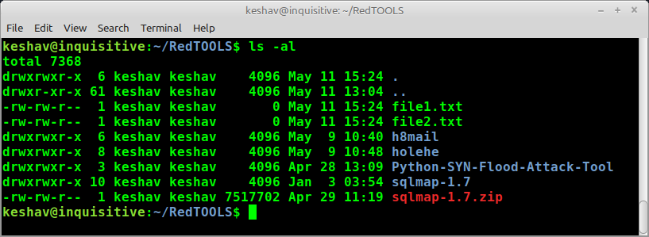
All theory concept covered , now move on the practical ,
Open your terminal and type ls -al command , all files/folders printed in your terminal with their permission ,
NOTE: Only those files will be printed in the folder you are in
File Owner name
Groups user name
Focus on only file1.txt and file2.txt we going to learn with these two file,
We can change file permissions with chmod command

Slide 20
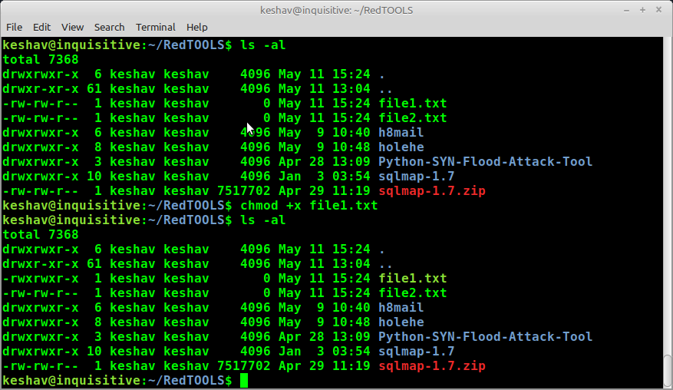
Let’s see, how we practically change file permission
Example given below
See difference, execute permission added
I give +x ,+ sign use to add and x(execute)
+x (add execute permission to this file

